Slide 1
Membership Inference Attacks Against Machine Learning Models
Reza Shokri, Marco Stronati, Congzheng Song, Vitaly Shmatikov
Cornell Tech, INRIA

Slide 2
Problem statement
Machine learning shows superior performance in different domains (vision, natural language detection, malware detection, robotics)
Machine learning is the foundation of new, easy-to-use, popular Internet services (Google Prediction API, Amazon Machine Learning, BigML)
Machine learning requires data about individual users (purchases, preferences, health data, online/offline transactions, photos, spoken commands, locations)

Slide 3
Problem statement
Do model predictions leak information about training data?
It is important that an attacker CAN NOT infer about the information about individuals from a trained model
Membership Inference Attack (MIA): Determine whether a given data record was part of the training dataset or not

Slide 4
Key Contributions
Quantify membership information leakage through the prediction outputs of machine learning models
State the membership inference problem as a binary classification problem
Introduction of shadow training
Several effective methods to generate training data for shadow models

Slide 5
Key Contributions
Evaluation against Neural networks and black-box models (ML-as-a-service platforms)
Discussion of root causes for the availability of the attacks
Quantitative comparison of mitigation strategies

Slide 6
Results
Model for Membership Inference Attacks & Tool to measure the membership risk
Insights about the reason for Membership Inference Attacks
Overfitting
Structure and Type of the model
Mitigation strategies against Membership Inference Attacks
Regularization
Double precision rounding

Slide 7
Results
Models from machine-learning-as-a-service platforms leak information about their training data
For multi-class classification models membership inference achieves 94% (Google) and 74% (Amazon)
Texas hospital discharge dataset (over 70%) presents a risk to privacy of health-care data of individuals

Slide 8
Meaning of this work
Design, implementation and evaluation of the first membership inference attack against machine learning models
Shows clearly that Machine Learning Models leak information about their training data
For machine learning models the utility (prediction accuracy) and privacy are not in a direct conflict
In fact it is possible to train models, that are utility preserving and fulfill privacy requirements

Slide 9
Machine Learning Background
Machine Learning:
Extract useful features from given data
Learn a model that can generalize to data beyond the training set
Unsupervised Learning:
Unlabeled data
Build a model that explains hidden structures in the data
Supervised Learning:
Labeled data
Learn the relationship between the data and assigned labels

Slide 10
Machine Learning Background
Overfitting:
Model that performs better on the training data than on unseen data (same population)
Regularization:
Techniques to prevent overfitting (L2, Pruning, Distillation)
Precision:
Fraction of relevant instances among the retrieved instances
Recall:
Fraction of retrieved relevant instances over the total amount of relevant instance

Slide 11








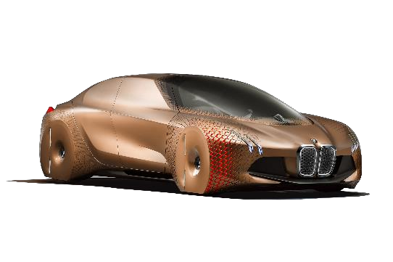

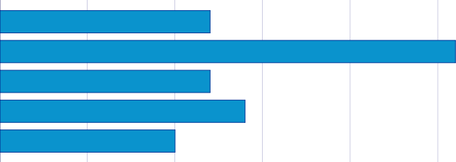
Machine-Learning-as-a-service
Model
Prediction API
Input Data Classification
Training API
Data
Truck
Car
Boat
Plane
Dog

Slide 12

Machine-Learning-as-a-service
Black Box
Model details and training algorithms are hidden
Model type chosen by the service adaptively, depending on the data accuracy
No warning about consequences of overfitting
Little or no control over regularization.
Models cannot be downloaded and are
Models can only be accessed through the services API
Charging customers for queries through the API
APIs

Slide 13


Membership Inference Attack
Model
Prediction API
Training API
Input Data
Classification Data
Do model predictions leak information
about training data?

Slide 14
Membership Inference Attack
Model
Was this specific data record part of the training dataset?
Prediction API
Input Data Classification
Training API
Data
Truck
Car
Boat
Plane
Dog

Slide 15
Problem Statement
Given:
Input Samples: Labeled data records from some population
Model outputs: Prediction vector of probabilities (confidence values), one per class
The class with the highest confidence value is selected as the predicted label for the data record
Black Box
Model
Prediction API
Input Data Classification
Training API
Data
Truck
Car
Boat
Plane
Dog

Slide 16
Problem Statement
Assumption1
Machine Learning is used to train a classification model that captures the relationship between the content of the data records and their labels
Black Box
Model
Prediction API
Input Data Classification
Training API
Main Insight: ML models over fit to their training data
Data
Truck
Car
Boat
Plane
Dog

Slide 17


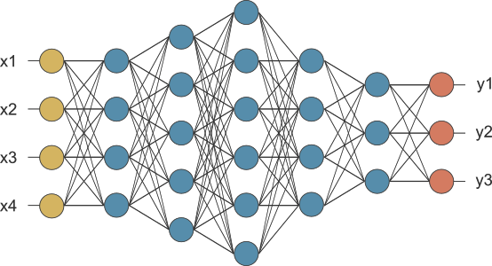
Problem Statement
Assumption 2
ML models often behave differently on the data that they were trained on versus the data that they “see” for the first time
Input data from the training set
Truck
Car
Boat
Plane
Dog
Prediction API
Difference in the output!
Input data from the training set
Truck
Car
Boat
Plane
Dog
Train an ML model to recognize the differences!

Slide 18
Problem Statement
Assumptions about the Attacker:
Query access to the model -> obtain prediction vector on any data record.
Knowledge about input & output format of the model (including number and range of values)
Knowledge about type, architecture, and training algorithm of the model
Black-box access to a machine learning oracle, that was used to train the model
No knowledge about model structure or meta-parameters
Background knowledge about the data population
Background knowledge about general data population statistics (Marginal distribution of feature values)

Slide 19
Problem Statement
Metrics:
Precision: Fraction of records inferred as members are indeed members of the training dataset
Recall: Fraction of the training dataset members correctly inferred as members by the attacker

Slide 20
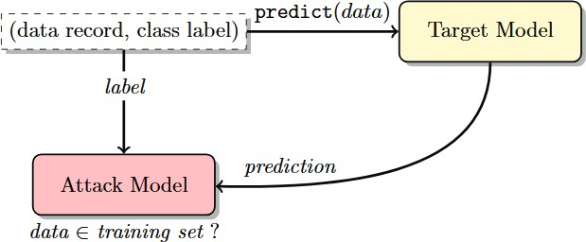
Membership Inference
Membership inference attack in the black-box setting
End-to-End attack process:
Attacker queries the target model with a data record and obtains the models prediction vector
Feed the prediction vector and the label of the target model to the attack model (Label, since the distribution of the output depends heavily on the true class of the input)
Attack model infers whether the record was in or out of the training dataset of the target model

Slide 21
Membership Inference
Reason for the different behavior
Overfitting
Structure and Type of the model
Proposed attack
Collection of models
One model for each output class
This increases accuracy of the attack because the target model produces different distributions over its outp ut classes depending on the input’s true class.
Shadow models
Intended to behave similarly to the target model
In contrast to the target model, one knows the ground truth for each shadow model

Slide 22


Shadow Models
Shadow Model 1
Shadow Model 2
Shadow Model k
Classification
Classification
Classification
Train
Test
Train
Test
Train
Test
Attack Training
Set
In
Out
In
Out
In
Out
Train the attack model
to predict if an input was a member
of the training set (in) or a non-member (out)

Slide 23
Shadow Models
Similar models trained on relatively similar data records using the same service behave i n a similar way. (Imitation of the target model)
One shadow model for each class
The attack will perform better if the training datasets happen to overlap
Must be trained in a similar way to the target model
For ML-as-a-service, the attacker can use exactly the same service to train the shadow model as was used to train the target model
The more shadow models, the more accurate the attack model will be

Slide 24
Shadow Models
Assumptions
Knowledge of type and architecture of the target model
Training data with the same underlying distribution as the training data of the target model
Training dataset for the shadow models is disjoint from the private datasets used to train the targ
et model

Slide 25
Generating training data for shadow models
Real data
Similar to training data of the target model (i.e., drawn from the same distribution)
Synthetic data
Use a sampling algorithm to obtain data classified with high confidence by the target model

Slide 26
Generating training data for shadow models
Model-based synthesis:
Attacker does not have real training data nor any statistics about its distribution
Generate synthetic training querying the target model
Intuition:
High confidence (synthetic) samples target model should be statistic ally similar to the targets training dataset
Procedure
Search the input space and find inputs that are classified with high confidence (hill climbing algorithm)
Sample synthetic data

Slide 27
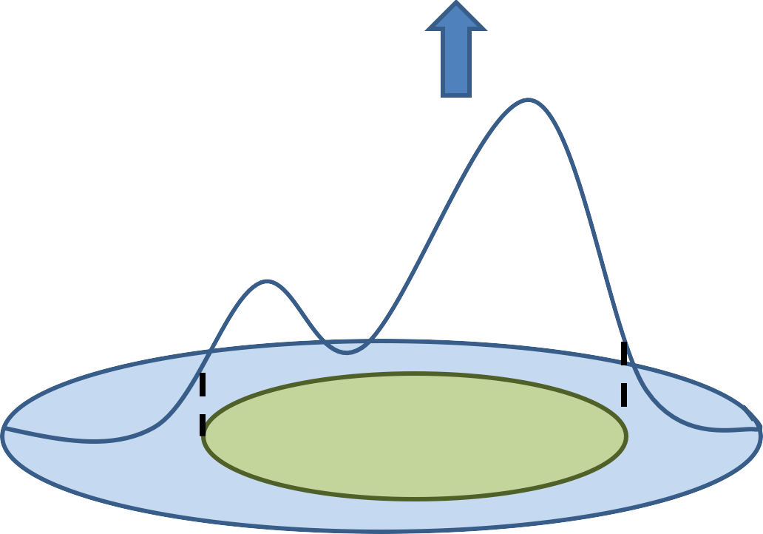
Generating training data for shadow models
Select high confidence samples
Prediction API
Classification
Input
High Confidence
Input space

Slide 28
Generating training data for shadow models
Statistics-based synthesis:
Use statistical information about the population from which the target model training data was drawn(Prior knowledge of the marginal distributions of different features)
In experiments: Generate synthetic training records for the shadow models by independently sampling the value of each feature from its own marginal distribution
Noisy real data
Attacker may have access to some data that is similar to the target model’s training data and can be considered as a “noisy” version thereof
In experiments: Simulate this by flipping the (binary) values of 10% or 20% randomly selected features, before training the shadow models

Slide 29
Datasets
CIFAR
Image based benchmark dataset for recognition
Use different fractions of the dataset to show the effect of the training dataset size in the accuracy of the attack
Image classification
Purchases
Shopping histories for several thousand individuals
Authors derived a simplified purchase dataset, where each record consists of 600 binary features. Each feature corresponds to a product and represents whether the user has purchased it or not.
5 different classification tasks {2,10,20,50,100} - Predict the purchase style

Slide 30
Datasets
Locations
Created from mobile users location “check-ins” in the Foursquare social network
Restricted to the Bangkok area For each location venue, geographical position and location type.
Partition the Bangkok map
446 binary features, whether a user visited a certain region or location type
Classify into 30 different geosocial types

Slide 31
Datasets
Texas hospital stays
Based on the Hospital Discharge Data public use
Files with information about inpatient stays in several health facilities
Each record contains four main groups of attributes:
External cause of injury (suicide, drug misuse)
Diagnosis (Schizophrenia, illegal abortion)
Underwent procedure of the patient (surgery)
Predict the patients main procedure based on the attributes other than secondary procedures

Slide 32
Datasets
MNIST
Handwritten digits
Classify numbers 0-10
UCI Adult (Census Income)
People dataset
14 features: age, gender, education, occupation, working hours, native country
Binary classification to predict if a person maker over $50K a year

Slide 33
Target models
Evaluated inference attacks on three types of target models: two constructed by cloud-based “machine learning as a service” platforms and one implemented locally
Machine-Learning-as-a-service:
Google Prediction API: No configuration parameters
Amazon ML: control over a few meta-parameters: maximum number of passes, L2 regularization amount
Neural Networks:
CIFAR: Convolutional Network
Purchase: Fully connected neural network

Slide 34
Experimental Setup
Training set and test set of each target and shadow model:
randomly selected from the respective datasets
same size
disjoint
No overlap between the dataset of the target model and those of the shadow models
Datasets used for different shadow models can overlap with each other.
Purchase: trained on Google API, Amazon ML & locally employing the same training dataset ->Compare leakage from different models

Slide 35
Experimental Setup
Dataset | Training set size | Cloud/Locally | # classes | # Shadow models
CIFAR | varies* | Locally | 10/100 | 100
Purchases | 10.000 | Cloud/Locally | {2,10,20,50,100} | 20
Locations | 1.200 | Cloud | 30 | 60
Texas hospital | 10.000 | Cloud |  | 10
MNIST | 10.000 | Cloud | 10 | 50
UCI Adult | 10.000 | Cloud | 2 | 20
*Training set sizes
CIFAR-10 : 2.500, 5.000, 10.000, 15.000;
CIFAR-100: 4.600, 10.520, 19.920, 29.540

Slide 36
Accuracy of the attack
Evaluate the attack by executing it on randomly reshuffled records from the target’s training and test datasets
Use sets of same size (i.e., equal number of members and non-members) in order to maximize the uncertainty of inference, thus the baseline is 0.5
Metrics: Precision, Recall

Slide 37
Accuracy of the attack
Most measurements are reported per class because the accuracy of the attack can vary considerably for different classes
This is due to the difference in size and composition of the training data belonging to each class and highly depends on the dataset

Slide 38
Accuracy of the attack
Different classes while varying the size of the training datasets
Test accuracy of 0.6 and 0.2 for CIFAR-10 and CIFAR-100
Test accuracy is low, indicating that the models are heavily overfitted

Slide 39
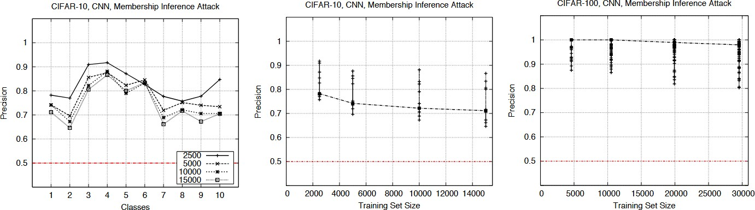
Accuracy of the attack
Precision of the membership inference attack against neural networks trained on CIFAR
The attack performs much better than the baseline

Slide 40
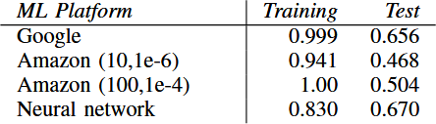
Accuracy of the attack
Training & Test accuracy of the models constructed using ML-as-a-service (Purchase dataset 100 classes)
Large gaps between Training & Test set indicate overfitting
Larger test accuracy indicates better generalizability and higher predictive power

Slide 41
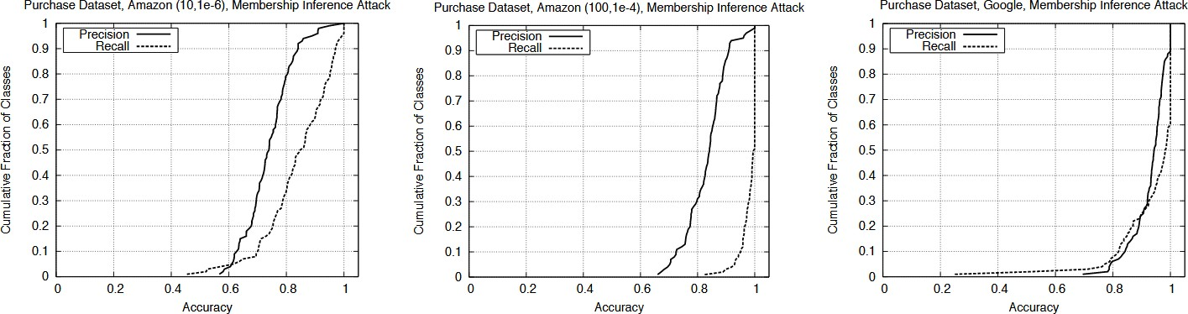
Accuracy of the attack
Empirical CDF of the precision and recall of the membership inference attack against different classes of the models train ed using Amazon ML and Google API on 10.000 purchase records

Slide 42
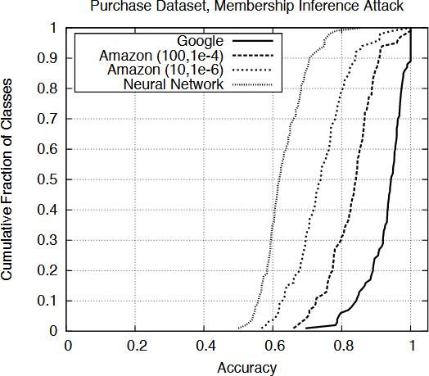
Accuracy of the attack
Precision of MIA against models trained on the same datasets by using different platforms
The attack model is a neural network
Google Prediction API exhibit the biggest leakage

Slide 43
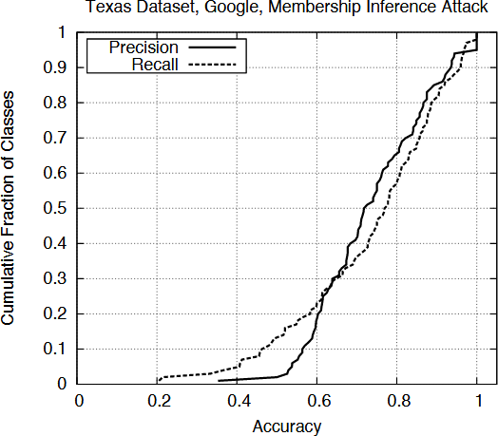
Accuracy of the attack
Precision and Recall of the MIA against the classification model trained using Google Prediction API (Texas hospital-stay dataset)
Training accuracy of the target model: 0.66
Test accuracy of the target model: 0.51
Precision is mostly above 0.6
For half of the classes, precision is above 0.7
For more than 20 classes precision is above 0.85

Slide 44
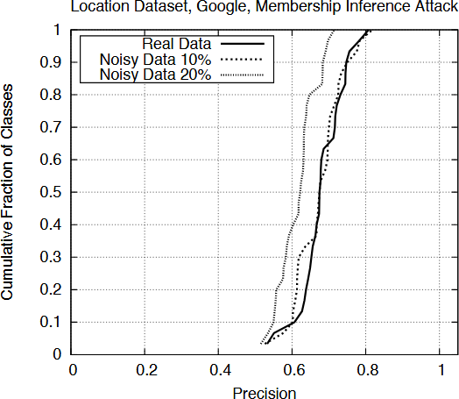
Accuracy of the attack
Empirical CDF of the precision of the MAI against the Google-trained model (location dataset)
Training accuracy of the target model: 1.0
Test accuracy of the target model: 0.66
Precision is between 0.6 and 0.8 with an almost constant recall of 1.0

Slide 45
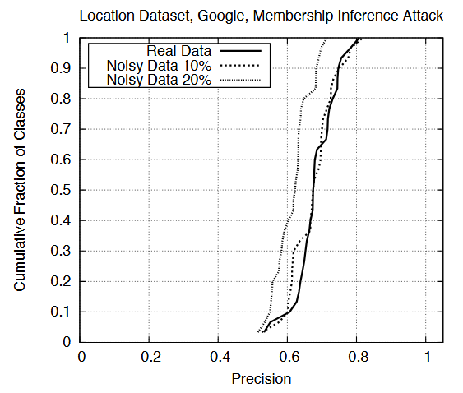
Effect of shadow training data
Empirical CDF of the precision of the MAI against the Google-trained model (location dataset)
Precision drops as the amount of noise increases
The attack outperforms baseline
The attacks are robust even if the attacker’s assumptions about the distribution of the target models training data are not very accurate

Slide 46
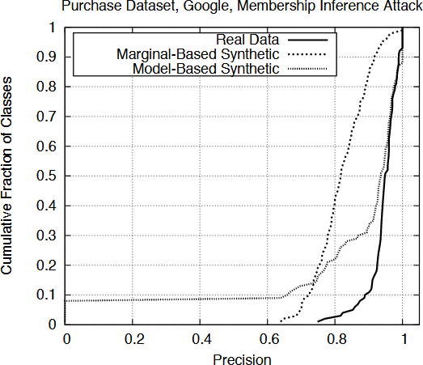
Effect of shadow training data
Empirical CDF of the precision of the MIA against the Google-trained model (location dataset)
Use marginal distributions of individual features to generate 187.300 synthetic purchase records
Train 20 shadow models on these records
Also generate 300.000 synthetic records using the model-based approach
Train 8 shadow models on these records

Slide 47
Effect of shadow training data
Accuracy of marginal-based is noticeably reduced
Nevertheless very high for most classes
Dual behavior model-based data:
For most classes high precision and close to the attacks that use real data
few classes with very low precision
Data | Precision
Real data | 0.935
Marginal-based synthetic | 0.795
Model-based synthetic | 0.896

Slide 48
Effect of shadow training data
Reason for low attack precision on some classes:
Underrepresentation of classes in the data samples: Target classifier cannot confidently model distribution of data records belonging to these classes
These classes are underrepresented in the target model’s training dataset
The membership inference attack can be trained with only black-box access to the target model, without any prior knowledge about the distribution of the target model’s training data

Slide 49
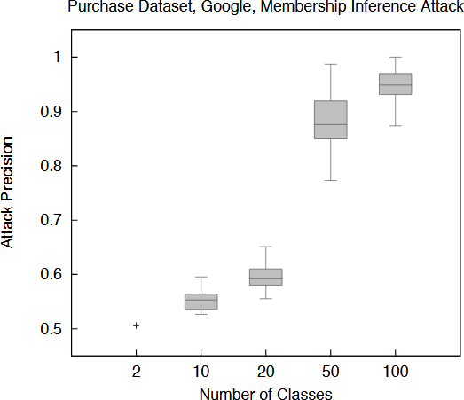
Effect of the number of classes and training data per class
Distribution of attack precision on the purchase dataset with {2,10,20,50,100} classes trained on the Google platform
The more classes, the more signals about the internal state of the model are available to the attacker
For same number of training records per class, the attack is better against CIFAR-100, than CIFAR-10
Models with fewer classes leak less information about their training inputs
With more classes, needs to extract more distinctive features need to be extracted
Models with more output classes they leak more information

Slide 50
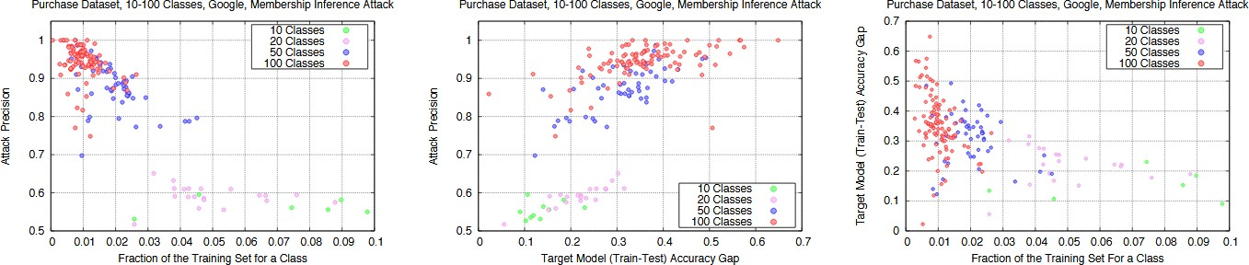
Effect of the number of classes and training data per class
Relationship between precision of the MIA on a class and train-test accuracy gap of the target model Fraction of the training dataset that belongs to this class
The more data in the training dataset is associated with a given class, the lower the attack precision f or that class

Slide 51
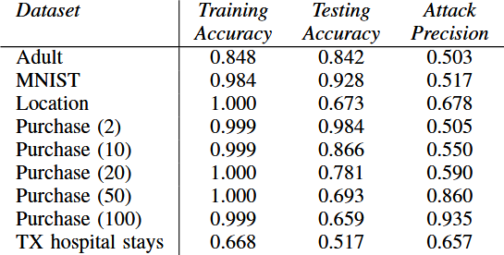
Effect of the number of classes and training data per class
Precision of membership inference against Google-trained models

Slide 52
Effect of the number of classes and training data per class
MNIST
The lack of randomness in the training data for each class and the small number of classes contribute to the failure of the attack
Adult dataset
Two possible reasons for this failure:
The model is not overfitted
The model is a binary classifier, which means that the attacker has to distinguish members from non-members by observing the behavior of the model on essentially 1 signal, since the two outputs are complements of each other.

Slide 53
Effect of overfitting
The more overfitted a model, the more it leaks
Overfitting is not the only factor that causes a model to be vulnerable to membership inference
The structure and type of the model also contribute to the problem
Bigger train-test accuracy gaps indicate that the model is overfitted for that class

Slide 54
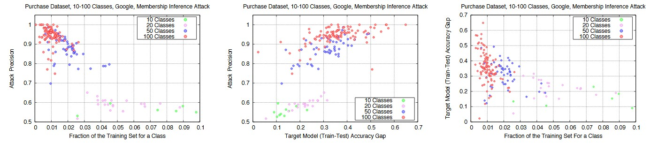
Effect of overfitting
Relationship between precision of the MIA on a class and train-test accuracy gap of the target model Fraction of the training dataset that belongs to this class

Slide 55
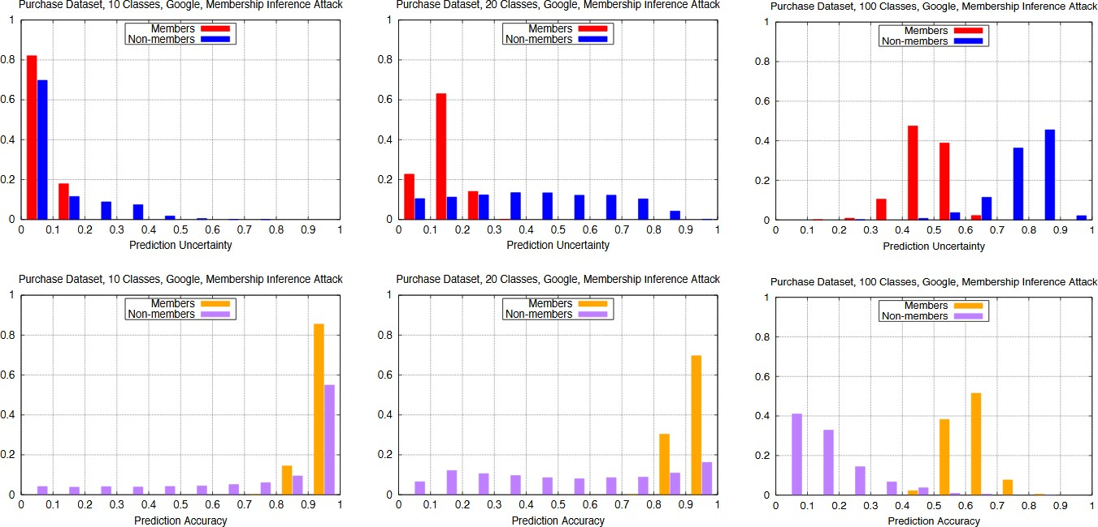
Why does the attack work?
Classification uncertainty (top row) and prediction accuracy (bottom row) of the target model for the members of its training dataset vs. non-members, visualized for several sample classes

Slide 56
Why does the attack work?
There is an observable difference between the output (both accuracy and uncertainty) of the model on the member inputs versus the non-member inputs in the cases were he attack is successful

Slide 57
Why does the attack work?
Success of membership of inference is directly related to:
Generalizability of the target model and
Diversity of its training data.
Overfitted models lack predictive power and leak sensitive information about the training data

Slide 58
Mitigation strategies
Restrict the prediction vector to top k classes
When the number of classes is large, many classes may have very small probabilities in the model’s prediction vector.
Coarsen precision of the prediction vector
Round the classification probabilities in the prediction vector to d floating point digits The smaller d is, the less information the model leaks

Slide 59
Mitigation strategies
Increase entropy of the prediction vector
Membership inference exploits the difference between the prediction entropy of the target model on its training inputs versus other inputs
Add softmax layer and increase its normalizing temperature t>0 (knowledge distillation)
Use regularization
L2-norm standard regularization: Penalizes large weight parameters

Slide 60
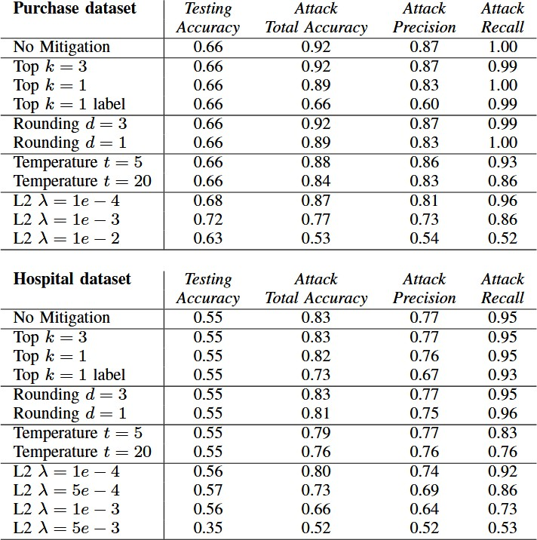
Mitigation strategies

Slide 61
Mitigation strategies
Baseline: Neural Network with one hidden layer
Implemented mitigation strategies did not impose any cost on the target model’s prediction accuracy
In case of regularization, the target models prediction accuracy increased

Slide 62
Mitigation strategies
Restricting the prediction vector to a single label is not enough to fully prevent membership inference
The attack can still exploit mislabeling behavior:
Members and non-members are mislabeled differently (assigned to different wrong classes)
If the prediction vector contains probabilities in addition to the labels, the model leaks even more information

Slide 63
Result summary
The accuracy of the attack on synthetic data is less than that on real data
Reason: Quality of the synthetic data is not the same for all the classes
Some classes in the target model’s training data are underrepresented
The attacks are robust to noisy real data.
More number of classes requires the model to store more information about the data, hence leaking more information

Slide 64
Main Assumptions
The attacker can obtain the output of the target model on any input record using a black-box query access. The range and format of the input and output of the model is known to the attacker
The attacker may know the type and architecture of the training algorithm and the model
Knowledge of the data universe from which the training data is derived may be available to the attacker

Slide 65
Main Assumptions
Behavior of machine learning models differs for the data on which they were trained and the data which they encounter for the first time
Similar models trained on relatively similar data records using the same service behave in a similar way
The more generalizability of the target model and the better the training data is representative of the overall population, the less are the chances of data leakage

Slide 66
Conclusion
Pioneering work on membership inference attack against machine learning models
Attack of black-box models trained in the cloud using Google Prediction API and Amazon ML
General, quantitative approach to understanding the leakage of information about training data
Introduction of shadow training: Approximations of the training data with known labels

Slide 67
Conclusion
Demonstration of the usage of shadow training with synthetic or noisy data
In case of synthetic data, no prior knowledge about the distribution training data is needed.
The results have substantial practical privacy implications
The accuracy of the attack on synthetic data is less than that on real data Reason: Quality of the synthetic data is not the same for all classes

Slide 68
Conclusion
Some classes in the target models training data are underrepresented
The attacks are robust to noisy real data
More number of classes requires the model to store more information -> leaking more information

Slide 69
Critical thoughts/Improvements
The paper mentions that for under-represented classes in case of synthetic data, the attack mod el doesn’t work that well, but it does not suggest any strategies to improve results in this case
The hypothesis that more shadow models the accurate the attack model is not empirically supported

Slide 70
Critical thoughts/Improvements
The paper uses only same types of models for the shadow models. How does the attacker know the target model? What happens for different types of models?
The paper is discussed only in the context of a multi-class classification problem

Slide 71
Questions

